Slide 1
C# Fundamentals
Object-Oriented Programming

Slide 2
C# Fundamentals - OOP Table of Contents
Class
Objects(instances)
Status and behavior regarding OOP
Inheritance
Polymorphism
Encapsulation
Modularity

Slide 3
C# Fundamentals - OOP Classes
A class is an extensible program-code-template for creating objects, providing initial values for state (member variables) and implementations of behavior (member functions, methods).
A class is a construct that enables you to create your own custom types by grouping together variables of other types, methods and events.
It defines the data and behavior of a type.

Slide 4

C# Fundamentals - OOP Classes
Declaring Classes
public : Access level
class : keyword used to declare a class.
Customer : name of class

Slide 5
C# Fundamentals - OOP Objects
Basically an object is created from a class.
An object is a concrete entity based on a class.
Objects are also called instances.
Look around right now and you'll find many examples of real-world objects: your dog, your desk, your television set, your bicycle.

Slide 6

C# Fundamentals - OOP Objects
Creating Objects :
Customer : name of class that defines a type of object.
object1 : name variable of a concrete entity.
"new" operator is used to create instances of classes.

Slide 7
C# Fundamentals - OOP status and behavior
An object has an state and behavior and identity.
The state of an object represents a characteristic, trait, quality, or feature that contribute to making an object uniquely.
For example some states of real-word objects :
Dogs might have states like name, color, breed, hungry, etc.
A radio might have states like on, off, current volume, current station , etc.

Slide 8
C# Fundamentals - OOP Inheritance
Inheritance enables you to create new classes that reuse, extend, and modify the behavior that is defined in other classes.
The class whose members are inherited is called the base class, and the class that inherits those members is called the derived class.

Slide 9
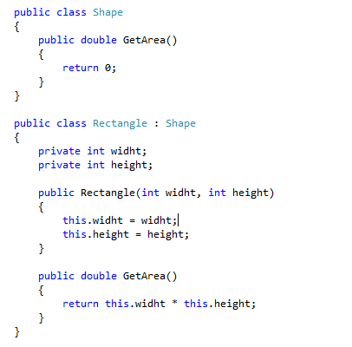
C# Fundamentals - OOP Inheritance
Example inheritance :

Slide 10
C# Fundamentals - OOP Inheritance
Access Modifiers for inheritance :
abstract : The abstract modifier indicates that the thing being modified has a missing or incomplete implementation.
virtual : The virtual keyword is used to modify a method, property, indexer, or event declaration and allow for it to be overridden in a derived class
override : The override modifier is required to extend or modify the abstract or virtual implementation of an inherited method, property, indexer, or event.
sealed : the sealed modifier prevents other classes from inheriting from it.

